Slide 1
5 Question Zoom Quiz
The goal isn't to be right. We actually ignore correct answers and only focus on what people get wrong to know where to spend more time explaining.
Once the quiz reaches quorum we'll start.
Notes:
If you think you'll get the answers wrong please take the quiz. We actually ignore correct answers and only focus on what people get wrong.

Slide 2
Chapter 1: Reliable, Scalable, and Maintainable Applications
Designing Data‑Intensive Systems – 30‑minute overview
Notes:
Welcome everyone. Over the next thirty minutes we’re going to unpack Chapter 1 of *Designing Data‑Intensive Applications*, which lays the foundation for every architecture decision you’ll make when you build or operate a modern backend.
The agenda is simple: we’ll define three big quality pillars—reliability, scalability, and maintainability—then dig into concrete techniques and pitfalls the chapter highlights. Even if you’ve never heard the term ‘data‑intensive’, you already live in that world: whether you work on search, analytics, IoT or payments, the bottlenecks are almost always about **data size, data complexity, or data velocity**, not CPU instructions.
By the end you’ll be able to:
• spot the difference between a *fault* and a *failure*,
• translate a business growth scenario into a load parameter,
• and explain why ‘simple’ code can still be impossible to change in production.
All slides use plain layouts so you can drop this deck straight into Google Slides and rearrange or extend it as your own. Let’s get started.

Slide 3
Key Pillars (1/2)
Reliability: continues to deliver the **correct** results even when components misbehave
Scalability: maintains acceptable performance when **load parameters** grow
Maintainability: remains **easy for humans** to understand, operate, and evolve
Notes:
The book starts with three non‑functional requirements that show up in every design doc.
**Reliability** is not abstract perfection—it means the system *still* works even when a disk fails, a kernel bug is triggered, or somebody fat‑fingers a config flag at 3 a.m.
**Scalability** asks a different question: what happens when the same software has to cope with ten or a hundred times the volume? You can’t just say “it scales”; you have to name a load parameter—requests per second, dataset size, fan‑out—and show how the architecture adapts.
Finally, **maintainability** is the long game. It’s the difference between a codebase you can iterate on every week and one that petrifies after the original author leaves. The chapter frames maintainability through operability, simplicity, and evolvability, which we’ll revisit soon.

Slide 4
Key Pillars (2/2) – Why They Matter
User Trust: outages or corrupt data erode confidence faster than features build it
Cost Curve: poorly scaling code forces expensive hardware or rewrites
Team Velocity: complex, opaque systems slow every new feature or bug‑fix
Notes:
These pillars aren’t academic—they translate directly into cost.
*User trust* is fragile; a single incident that loses photos or brings down checkout during Black Friday can undo months of roadmap work.
*Cost curve* is about money and time. A data‑store that only scales by buying exotic hardware will hurt your margins and limit growth. Many teams get locked into “scaling by re‑write,” re‑implementing the same logic whenever they outgrow today’s constraints.
*Team velocity* ties it all together. If engineers need days to understand hidden couplings or recover from deployment surprises, innovation stalls. That’s why we treat reliability, scalability, and maintainability as **co‑equal first‑class requirements**, not after‑thought ‘‑ilities’. With that context, let’s dive deeper—starting with reliability.

Slide 5
Reliability – The Goal
Work Correctly: perform the intended function at the expected performance level
Fault ≠ Failure: design so *individual* faults don't become *user‑visible* failures
Fault Tolerance: redundancy, isolation, and recovery over prevention
Notes:
Reliability starts by defining what “correct” means for your service. For a key‑value store it might be “every acknowledged write is durable and every read returns the latest acknowledged value.”
From there the chapter stresses a crucial distinction: a **fault** is an internal deviation like a burnt‑out disk, a kernel panic, or a process crash. A **failure** is when the user sees something wrong—an error response, stale data, or unacceptable latency. We can never eliminate all faults, but we can *contain* them so they don’t escalate into failures .
That containment toolkit is fault tolerance: redundant components, isolation boundaries, fast detection, and automated recovery—think RAID for disks, replica sets for databases, and rolling restarts for services. Notice the emphasis on tolerance *over* prevention: you simply cannot debug cosmic rays or human typos out of existence.

Slide 6
Three Sources of Faults
Hardware: disks die (~1 per day per 10 k drives), power goes out, NICs flap
Software: systematic bugs—e.g., Linux leap‑second hang (2012)
Human: mis‑configurations dominate outage reports
Notes:
We'll examine the full diagram on the next slide; focus on the bullet points here. NICs flap - temporarly loss in connectivity of drives (cable/network)
**Hardware faults** feel random and independent. A fleet with 10 k spinning disks statistically expects a failure every day, so we replicate or RAID them.
**Software faults** are nastier. They’re correlated—one bad input or quirks like the 2012 leap second can crash every JVM simultaneously. Netflix combats this with Chaos Monkey, deliberately killing instances to keep recovery paths sharp.
**Human faults** are the #1 root cause in most post‑mortems. The fix isn’t better humans; it’s safer systems: layered reviews, sandbox environments, and one‑click rollbacks. Keep these categories in mind—they drive different mitigation strategies.

Slide 7
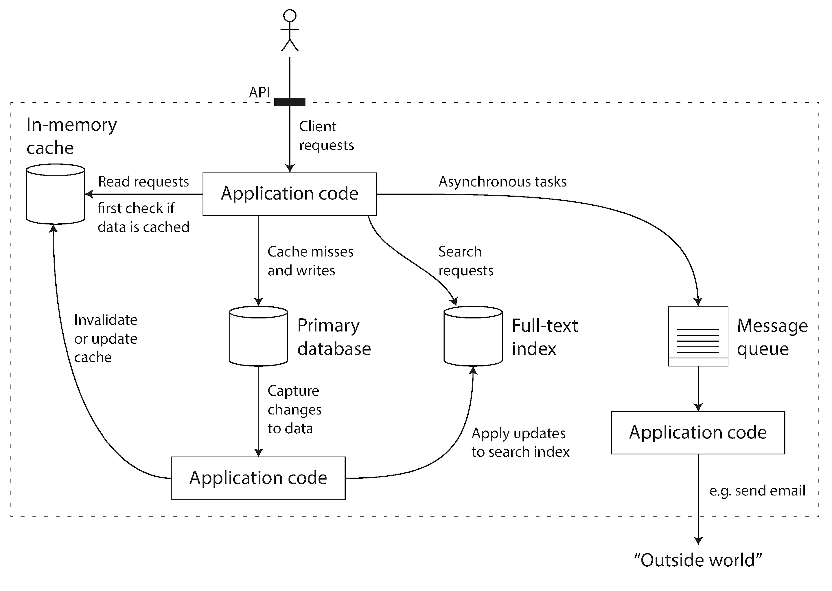
Figure 1‑1: Composite Data System Architecture
Notes:
This dedicated slide lets us walk through Figure 1‑1 in detail without crowding the bullets on the previous slide.
**What you’re seeing**
Page 3’s architecture diagram (on the slide) reminds us that real systems are **composites**: app servers, caches, databases, search indexes, queues. Each link is a new failure surface.
• The dashed box represents a single **service** boundary exposed to clients via an API.
• Inside that boundary, the application combines an **in‑memory cache**, the **primary database**, a **full‑text index**, and a **message queue**.
• Application code propagates state changes: when new data is written, the cache is invalidated, the search index is updated, and asynchronous tasks are queued.
**Why it matters**
The diagram makes two points:
1. Real systems are **compositions of specialised data systems** rather than a monolithic “database that does everything.”
2. Once you stitch components together, **you become the data‑system designer** responsible for end‑to‑end guarantees like consistency between the cache and DB.
Call out how each arrow indicates data flow and potential failure surfaces. Use this as a segue into the next reliability mitigation techniques.

Slide 8
Mitigating Hardware Faults
Redundancy: RAID, dual PSUs, multi‑AZ replicas across failure domains
Automated Failover: detect unhealthy nodes & route traffic seamlessly
Rolling Upgrades: design so individual machines can be rebooted anytime
Notes:
Because hardware failures are expected, we fight them with **redundancy**. At the component level that’s mirrored disks or dual power supplies; at the system level it’s multi‑Availability‑Zone replicas.
Redundancy only helps if the system can **detect** a failed component and fail over automatically. A database that needs a human to promote a replica at 3 a.m. isn’t truly fault‑tolerant.
Finally, rolling upgrades: if your cluster can sustain N‑1 nodes, then rebooting one node for a kernel patch is no drama. The users never notice, and ops can patch on weekdays instead of scheduling downtime windows.

Slide 9
Mitigating Software Faults
Defense in Depth: isolation (process / containers) to limit blast radius
Inject Failure: Chaos Engineering validates error‑handling paths
Observability: metrics, structured logs & tracing expose latent defects
Notes:
Software bugs lurk in seldom‑used branches of code; they only surface under unusual load or inputs.
**Isolation**—separating tenants by process or container—reduces cascading crashes.
**Chaos Engineering** flips intuition: by *adding* controlled faults (killing processes, corrupting packets) you surface hidden assumptions before production traffic does. Netflix’s Simian Army is the textbook example.
Finally, **observability**. Rich metrics, high‑cardinality logs, and distributed traces act as a flight recorder. They let the on‑call engineer correlate an uptick in 500s to a specific canary release or JVM pause and fix it fast.

Slide 10
Mitigating Human Faults
Ergonomic Tooling: interfaces make the right action easy & wrong action hard
Safe Experimentation: production‑like sandboxes and staged roll‑outs
Fast Undo: versioned configs, immutable infrastructure, point‑in‑time restore
Notes:
Humans will always click the wrong button eventually. The fix is engineering psychology.
**Ergonomic tooling** uses clear naming, confirmation dialogs, and guardrails so the path of least resistance is also the safe path.
**Safe experimentation** means developers have a realistic sandbox seeded with production‑sized data and canary deployments that send just 1% of traffic to new code.
If things still go wrong, the golden rule is **fast undo**. Store configuration in Git, deploy with declarative tools like Terraform or Kubernetes, and keep automated database snapshots so rollback is a CLI command, not a war‑room event.

Slide 11
Scalability – What to Measure
Load Parameters: define *which* axis grows (req/s, data size, fan‑out, ...)
Workload Mix: ratio of reads/writes, average vs worst‑case request
Resource Model: CPU, memory, I/O, network & how they saturate
Notes:
You can’t discuss scalability without a ruler.
Start by picking **load parameters**—for a chat app it might be concurrent connections; for a map‑reduce cluster it’s dataset size. If the parameter doubles, how does throughput or latency react?
The **workload mix** matters as much as volume. 90% reads and 10% writes suggests very different optimizations than a write‑heavy log ingest service.
Finally map the workload to resources: CPU cores, heap size, disk IOPS, network packets. Only after you know which resource is the bottleneck should you debate caching, sharding, or rewriting.

Slide 12
Case Study – Twitter Fan‑Out v1
Approach 1: store tweets once; build home timeline *on‑read* by joining tables
Peak Load: 300 k timeline reads/sec vs 12 k tweet writes/sec
Bottleneck: expensive joins on every read overwhelmed DB
Notes:
We'll examine the full diagram on the next slide; focus on the bullet points here.
Reads outnumber writes by almost two orders of magnitude—300 k timeline requests per second versus 12 k tweet inserts. That magnifies the cost of each join until the database CPUs peg and p95 latency shoots sky‑high.
This illustrates a key lesson: a workload that looks balanced in the ER diagram can be wildly unbalanced in production. Simply “using SQL joins” wasn’t scalable under Twitter’s load parameters.

Slide 13
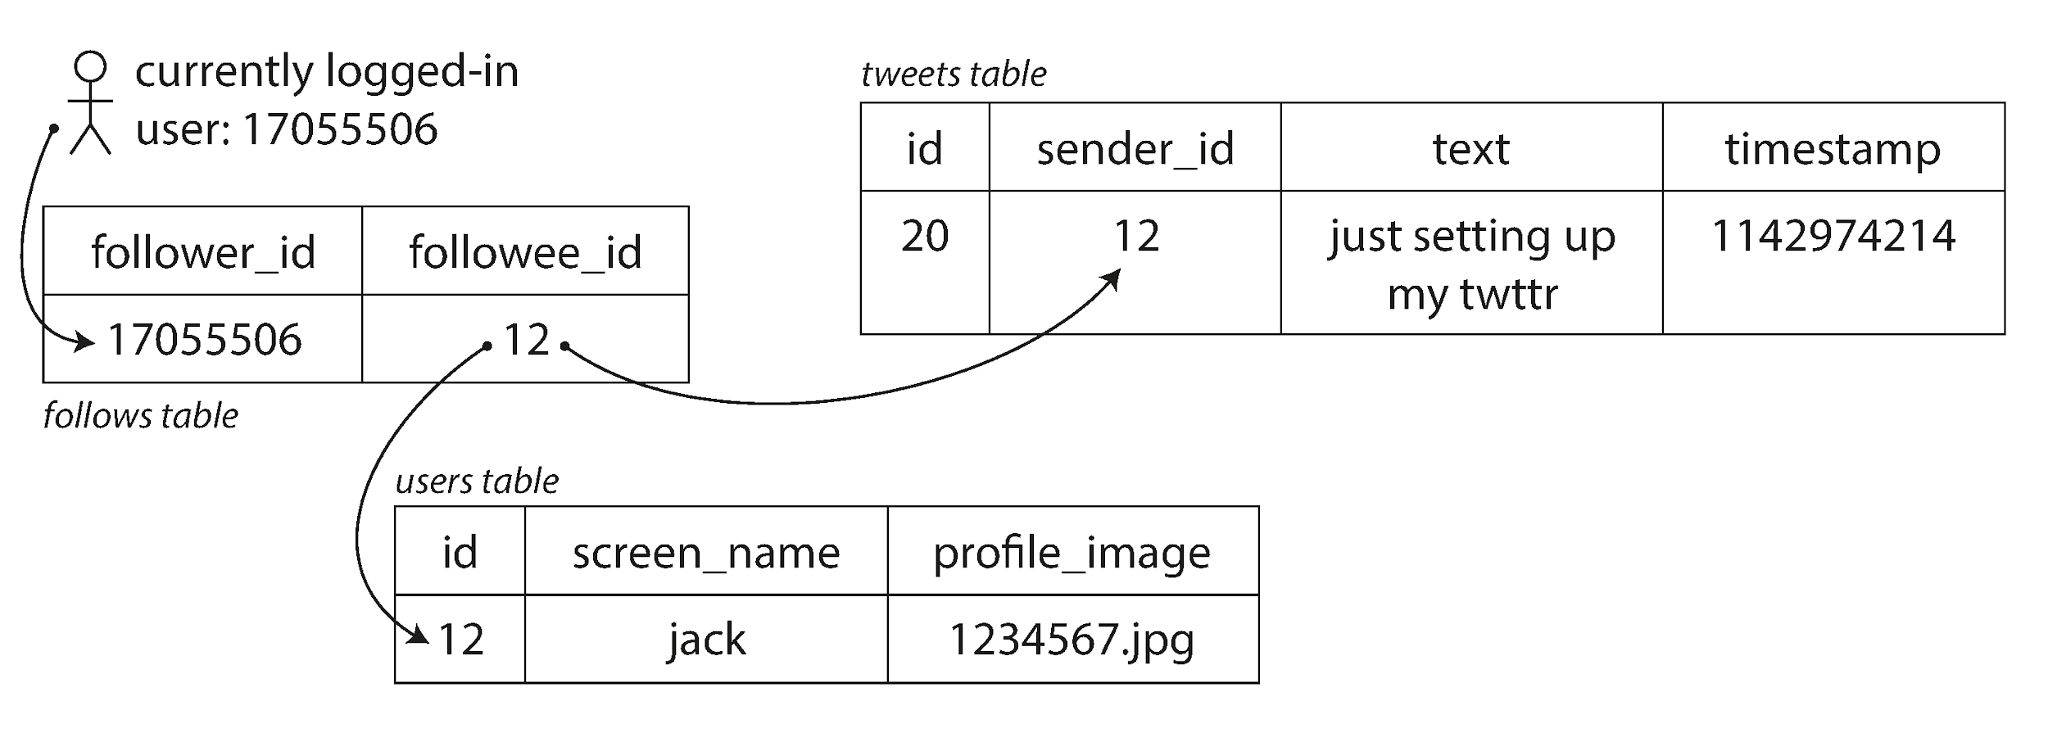
Figure 1‑2: Home‑Timeline Query (Fan‑Out on Read)
Notes:
Figure 1‑2 underpins our discussion of Twitter’s first approach—building a user’s home timeline on the fly.
**Reading the diagram**
The diagram taken from page 10 (figure 1‑2) shows Twitter’s **original** schema. When a user opened their home timeline, the app queried *tweets*, *users*, and *follows* to assemble a feed on the fly.
• The three tables—**tweets**, **users**, and **follows**—are joined every time a timeline request comes in.
• That join must fetch all recent tweets from every followee, sort them, and send them back.
**Key takeaways**
• The schema is deceptively simple, but the *query* is expensive because it touches many rows across multiple users.
• Under heavy read load (hundreds of thousands of requests per second) the database CPU saturates.
• This illustrates why understanding the **load parameter**—here: read frequency times fan‑out—is critical before choosing an architecture.

Slide 14
Case Study – Twitter Fan‑Out v2
Approach 2: **fan‑out on write** – push tweet into each follower's cache
Average Fan‑Out: 75 followers ⇒ 4.6 k writes → 345 k cache inserts/sec
Edge Case: celebrities with 30 M followers create huge spikes
Hybrid: fan‑out most users; fetch celebrity tweets on‑read
Notes:
We'll examine the full diagram on the next slide; focus on the bullet points here.
Page 10’s second diagram (figure 1‑3) flips the strategy: when Alice tweets, the service looks up her list of followers and writes the tweet ID into **each** follower’s timeline cache.
On average that’s 75 inserts per tweet, turning 4 .6 k writes/sec into 345 k—but reads drop to a lightweight cache lookup.
The snag is the **power‑law** distribution of followers. A single Lady Gaga post fans out to 30 million timelines, generating 30 million cache writes in under five seconds. Twitter solved this by going **hybrid**: normal users are fanned out on write; celebrity tweets are fetched on read and merged just‑in‑time.
The takeaway: scalable design often means different code paths for the common case and the pathological case.

Slide 15
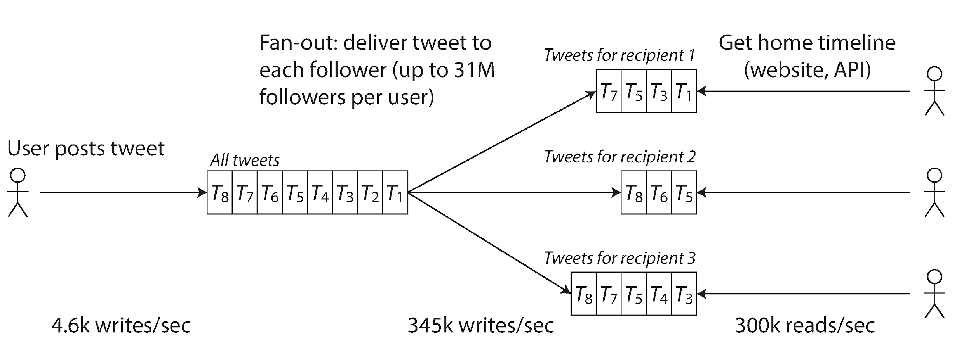
Figure 1‑3: Fan‑Out on Write Pipeline
Notes:
Figure 1‑3 shows Twitter’s revised pipeline where the heavy lifting happens at *write* time.
**Flow**
1. A user posts **T₁**.
2. The service looks up that user’s **followers** list.
3. The tweet ID is inserted into each follower’s **timeline cache**.
**Scalability Implications**
• Average fan‑out (~75 followers) turns 4.6 k writes/sec into 345 k cache inserts/sec—acceptable given write volume is lower than read volume.
• Celebrities with 30 M followers create extreme spikes; those are handled by the later hybrid optimisation we covered.
Explain how this pipeline trades write amplification for simpler, faster reads and why that fits the observed traffic pattern.

Slide 16
Throughput vs Response Time
Batch Systems: optimize **throughput** (records/sec, job runtime)
Online Systems: optimize **response time** distribution, not just average
Percentiles: p50 median, p95 long tail, p99.9 SLO contracts
Notes:
We'll examine the full diagram on the next slide; focus on the bullet points here.
Figure 1‑4 (extracted on this slide) plots 100 request latencies. Notice the spiky outliers—those are the tail latencies that ruin a user’s session even if the mean looks fine.
In batch processing we talk about **throughput**: how many records we can crunch per second. For interactive traffic we obsess over **response time**. But response time is a distribution, not a single number.
• **p50** (median) shows the ‘typical’ user.
• **p95** and **p99** capture the slowest one in twenty or one in a hundred.
• Many internal APIs at Amazon have SLOs set at **p99.9** to protect high‑value customers whose datasets trigger worst‑case behavior.
Designing for percentiles changes everything from queue sizing to timeout values.

Slide 17
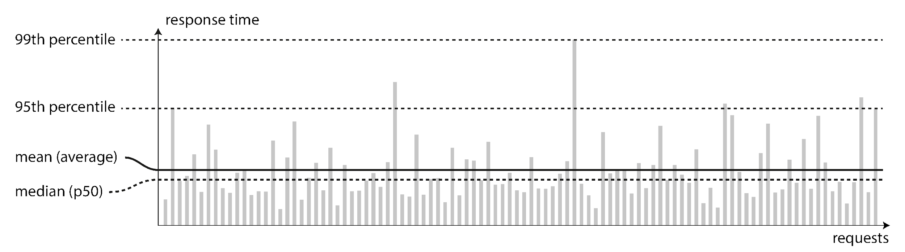
Figure 1‑4: Response‑Time Distribution
Notes:
This chart visualises why averages are misleading.
**How to read**
• Each bar is a request; height = latency.
• The dashed lines mark **mean**, **median (p50)**, **p95**, and **p99**.
**Talking points**
• Notice the long tail—most requests are <150 ms, but a few spike way beyond 500 ms.
• User experience is dominated by those tail latencies, not the mean.
• Designing for p99 often changes architecture: queue sizing, replication, timeouts, etc.
Encourage the audience to think about what their own latency histogram looks like and whether they monitor it.

Slide 18
Tail Latency Amplification
Multiple Backend Calls: end‑user latency = max(child calls)
Head‑of‑Line Blocking: one slow request delays everything queued behind it
Mitigations: replicate requests, shed load, prioritize oldest, stage isolation
Notes:
We'll examine the full diagram on the next slide; focus on the bullet points here.
This is **tail latency amplification**: the more RPCs you chain, the higher the chance at least one is in the 99th percentile.
Queues exacerbate the issue via **head‑of‑line blocking**—a slow operation sits at the front, and faster ones pile up behind it.
Mitigation patterns include:
• **Replica or hedged requests**—send the same RPC to two nodes and use the first response.
• **Load shedding**—fail fast when queues exceed a threshold.
• **Scheduling tricks**—serve oldest or small requests first to prevent starvation.
• **Service isolation**—run latency‑sensitive and batch workloads on separate fleets so they can’t interfere.

Slide 19
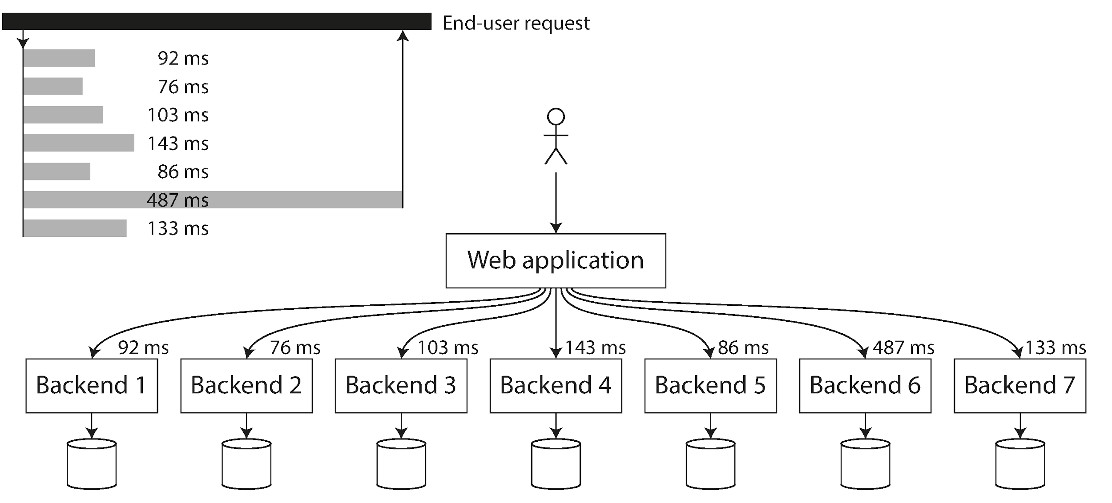
Figure 1‑5: Tail‑Latency Amplification
Notes:
Figure 1‑5 connects per‑service latency to end‑user experience.
**Walkthrough**
• The web application fans a request out to seven back‑end services.
• Even though most respond in ~90 ms, one service stalls at 487 ms, so the overall request takes ~487 ms.
**Implications**
• The *maximum* of child latencies, not the average, defines user‑perceived latency.
• Adding more microservices or queries multiplies the probability of hitting a slow tail.
• Mitigations include hedged requests, timeouts, request prioritisation, and service isolation.
Use the visual as proof that merely meeting p95 at each microservice is insufficient once they’re composed.

Slide 20
Scaling Strategies
Scale Up: buy a bigger box – simple but $$$ and capacity caps
Scale Out: shard across commodity nodes – complex but elastic
Elasticity: auto‑detect load & add/remove resources
Shared‑Nothing: each node independent ⇒ easier horizontal growth
Notes:
No single technique handles every growth curve. **Scaling up**—moving to a beefier instance—wins on simplicity and works for surprising volumes if your software is multithreaded, but specialised hardware gets expensive and eventually you top out.
**Scaling out** requires distributed coordination and data partitioning yet lets you grow by racking more commodity servers or spinning up cloud instances.
Modern architectures blend the two: a handful of well‑sized database masters plus many read replicas; or stateless microservices scaled horizontally while a few stateful systems scale vertically.
Elastic autoscaling adds another dimension—machines appear and disappear in response to traffic. That’s great for flash‑sale spikes but demands statelessness or fast data rebalancing.

Slide 21
Maintainability – Three Design Principles
Operability: day‑to‑day running *must* be boring
Simplicity: fight the **big ball of mud** by removing accidental complexity
Evolvability: enable safe, rapid change as requirements shift
Notes:
Martin Kleppmann frames maintainability through three lenses.
**Operability** is the ops team’s experience: alerts fire only for actionable issues; restarts are routine; documentation matches reality. A boring system is a success story.
**Simplicity** isn’t about fewer features; it’s about *understandability*. Remove accidental complexity—duplicate states, leaky abstractions, mysterious conventions—so a new hire can gain mental ownership quickly.
**Evolvability** means you can add fields, split components, or change storage engines without a six‑month rewrite. Practices like loose coupling, versioned schemas, and exhaustive automated tests make this possible.

Slide 22
Operational Excellence
Observability: logs, metrics, traces and health checks built‑in
Automation Hooks: first‑class support for container orchestration & CI/CD
Predictability: clear mental model – 'if I do X, Y happens'
Notes:
Operations teams thrive on **predictability**. They need to see problems coming and have confidence that routine tasks are safe.
That starts with **observability**: the code exports the right metrics, logs are structured and machine‑parsable, and distributed tracing ties a user’s UUID across microservices.
Next is **automation**. If your datastore can only be backed up or deployed by running ad‑hoc scripts on a specific host, things will break. Build in REST hooks, readiness probes, and idempotent config so tools like Kubernetes or Ansible can treat the service as cattle, not pets.
Finally, keep the mental model simple. Document invariants, default behaviors, and failure modes so that an on‑call engineer at 2 a.m. can predict the consequences of shutting down node 42.

Slide 23
Simplicity through Abstraction
Good Abstractions hide *implementation detail* behind a clean façade
Re‑use beats Re‑invent: shared components accrue quality improvements
Beware Leaky Layers: bad abstractions **add** complexity
Notes:
High‑level languages let us ignore registers and syscalls; SQL lets us ignore B‑tree pages and crash recovery. These are **good abstractions** – they expose a small, coherent surface and deliver on their promises.
When many teams reuse the same abstraction, every bug fix and performance win helps everyone. That shared investment raises the floor for the entire industry.
But abstractions can leak. An ORM that hides SQL yet requires you to tune every generated query has doubled your complexity. Design or choose abstractions that *reduce* cognitive load rather than shift it around.

Slide 24
Evolvability Patterns
Versioned Schemas & APIs: additive changes stay backward compatible
Refactoring: incremental, test‑driven reorganisations keep code fresh
Modularization: isolate contexts to limit blast radius of change
Notes:
Systems live longer than anyone expects; features come and go.
**Versioned schemas**—using migrations, semantic versioning, and backward‑compatible protobufs—mean you can roll a 2025 deploy without taking 2020 clients offline.
**Refactoring** at the system level mirrors what we do in code. Twitter’s shift from fan‑out‑on‑read to fan‑out‑on‑write was essentially an architectural refactor done in stages while the site stayed live.
Finally, **modularization**—whether microservices or carefully bounded contexts—localises change. You can replace the search subsystem or move from MySQL to Postgres without rewriting the payment flow.

Slide 25
Summary & Takeaways
Reliability: tolerate faults; focus on user‑visible correctness
Scalability: name your load parameters and measure percentile latency
Maintainability: design for people – operability, simplicity, evolvability
Notes:
We’ve covered a lot of ground, but the storyline is consistent.
First, pursue **reliability** by accepting that faults happen daily and engineering them out of the user’s experience.
Second, achieve **scalability** by quantifying load, measuring correctly, and choosing architectures that fit the skew and fan‑out of your real data.
Third, guarantee **maintainability** because the code you write this week will belong to someone else next quarter. Make their life easy, and future features will ship faster.
If you remember nothing else: *systems are socio‑technical*. Good architecture aligns with the messy, fallible humans who build and operate it.

Slide 26
Questions & Discussion
Which fault has bitten *you* most recently?
How does your current stack measure p99 latency?
What part of your system is hardest to change today?
Notes:
Thank you for your attention! These prompts often spark great hallway conversations.
• Think about the last outage or near‑miss you experienced—was it hardware, software, or human, and how might Chapter 1’s guidance have mitigated it?
• Many teams know their average latency but not their tail; do you track p99 or p99.9, and if not, what would it take to add those metrics?
• Finally, where does change feel painful? That’s a signal of low evolvability—maybe tight coupling, schema rigidity, or an un‑automated deployment path.
Let’s discuss!

